Slide 1

ALTER TECHNOLOGY TÜV NORD
Optical transceivers for space communications
David Poudereux
david.poudereux@altertechnology.com

Slide 2
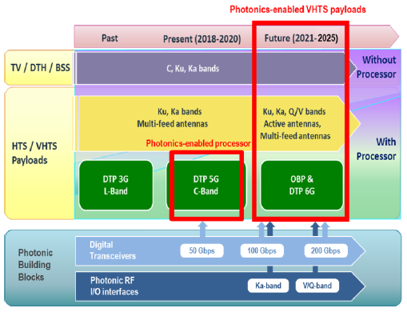
Introduction - motivation
The new "buzz-word" in the satellite communication (SatCom) industry is "HTS/VHTS“ (Very High Throughput Satellite).
The 2025 projections estimate a satellite capacity demand of 900 GHz from broadband access alone
Growth opportunities will continue to materialize such as those found in emerging regions, with TV distribution, government programs for rural connectivity, enterprise networks and cellular backhaul all continuing to grow over the next ten years.
Migration to higher frequencies (from Ka to Q/V, W…) must take place to make larger bandwidth available
Accommodating such payloads with large number of beams, the size, weight and power consumption (SWaP) constraints become a strong challenge
SatCom industry has no other option than to embrace a technology change
Notes:
The term VHTS characterizes the brand new class of Very/High Throughput Satellites that are developed and will be delivered from now on to cope with the operators need for high capacities and flexibility. Communication networks have entered the Exabyte-era and the new internet-style communications and data-centric applications are reshaping the network landscape and the corresponding markets from ground-to-space.
Figure : Historical evolution of SatCom payloads, present status and requirements towards future migration to photonics-enabled VTHS

Slide 3
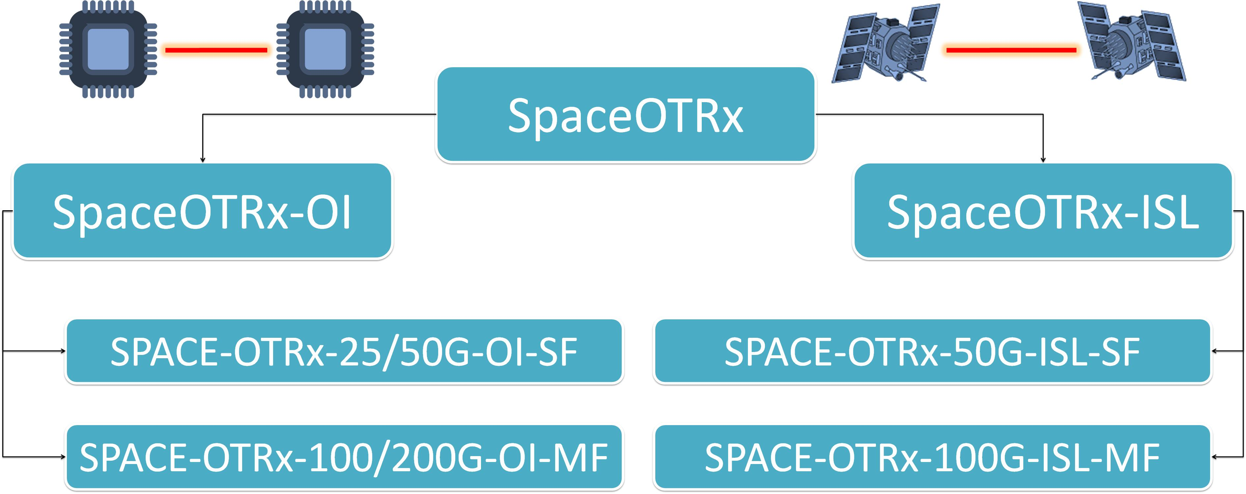
Introduction - MOTIVATION
ALTER TECHNOLOGY GROUP (ATG) has taken the strategic decision to develop and commercialize a family of space photonic transceiver products for SatCom applications:
  intra-satellite optical interconnects (OI) &
  inter-satellite lasercom-links (ISL)
ATG is setting-up the R&D frameworks for the product development
Space Optical Transceivers
Space OTRs – OI
Space OTRs – ISL
ATG will use its in-house hi-rel module assembly & packaging (ATG / OPTOCAP) as well as its large experience in parts reliability testing & system qualification
  Strategic partnerships with rad-hard IC developer & end-user has been established

Slide 4
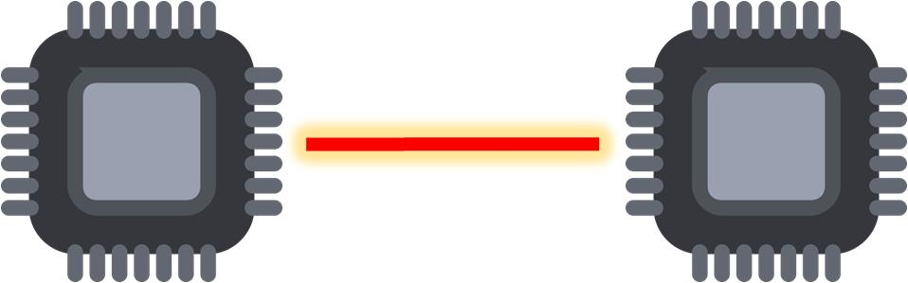
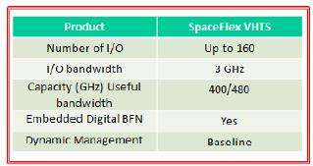
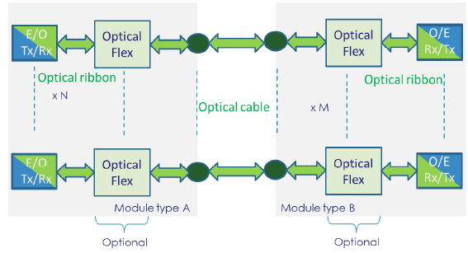
intra-satellite optical interconnects
Motivation
Target product: N x 25 Gb/s (line rate) space transceiver for optical interconnects on board satellite payloads
Board-level optical interconnection:
  VCSEL/PDs
  Rad-hard fiber pigtail
  Rad-hard electronic IC (VCSEL driver + TIA)
Current status equipments (data from main customers)
  Relies on 10 Gb/s OI technology
  Requirement for 25 Gb/s optical interfaces for the next gen systems
  Timeline for next-gen: 2023 flight equipment delivery
  Key drivers: Cost, Power consumption, technology penetration in constellations
Today: there is no commercial space-grade 25 Gb/s optical transceiver
ECSS SpaceFibre to roll-out -> technology standardization
Notes:
DTP (Digital Transparent Processor): allows to offer in orbit frequency plan flexibility in term of number of channels, size of channels and position of channels, with quite easy control interface.
The DTP modular architecture is based on the assembly in one single mechanical housing of different sub-assemblies:
· Receiver chains, at the analog input interface, implementing the A to D conversion of the analogue input signals.
· Transmitter chains, at the analogue input interface, implementing the D to A conversion and the analogue output signal transmission to the up-converters.
· Digital channel filtering, gain control and routing.
· A dedicated interface board, with serial bus interface for on board configuration.
· DC/DC converter boards whose voltages were customized for very low voltage high
power demand.
· Clock generation boards for digital processing and converters sampling frequency.
Thus, further to the flexibility in terms of functionality, the DTP also offers a high flexibility in term of modularity. It is achieved through the adaptation of several sub-assemblies of each type, depending on the customers needs (platform, frequency, number of inputs or outputs to be processed). It allows to tailor mass and volume budgets to the exact need of each customer.

Slide 5
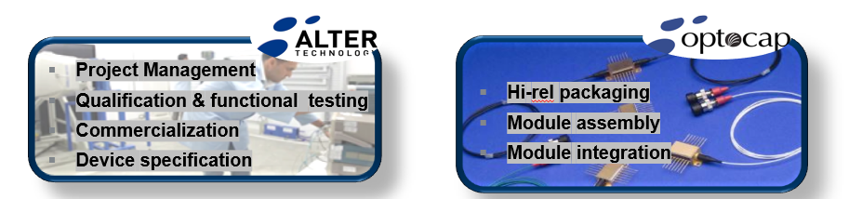
intra-satellite optical interconnects
APPLICATIONS & OBJECTIVES
  APPLICATIONS
  Satellite communications
    HTS/VHTS based on GEO satellites.
    LEO constellations of smaller and lower cost satellites
  Earth Observation and remote sensing payloads; high-speed OI are used for transferring the high data volume generated by high-resolution optical instruments or received by multiple antenna elements to the satellite processors.
  OBJECTIVES
  Development of the first European RH optical transceiver delivering an aggregate bit rate of 25 Gb/s
  Demonstration of the mass/power savings on system-level and environmental in a representative prototype system configuration
  Lot Validation Testing (LVT) of the O/E interfaces to verify reliability and demonstrate by test the target TRL level also on module level

Slide 6

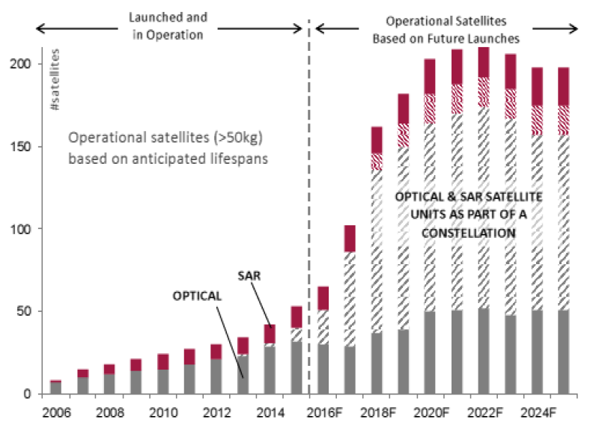
inter-satellite lasercom-links
Motivation
SatCom industry requires massive amounts of data transfer quickly, efficiently and at low cost
Laser communications have demonstrated their advantages in a real-world application
A number international programs were initiated with the target to demonstrate optical inter-satellite laser communications
The intention to bring optical inter-satellite laser communications aboard constellations is demonstrated by a number of investors and end-users, all announcing satellite fleets ranging from hundreds to a few thousands with the plan to optically interconnect the satellites such:
  LEOSAT programme (108 satellites)
  Telesat (120 satellites)
  SpaceX (4.000 satellites)
  Laserlight (MEO constellation in the range of 100's of gigabits)
Optical inter-satellite laser communications have to be low cost and low SWaP =>
The turn towards photonic integration is inevitable
Notes:
SatCom industry requires massive amounts of data transfer between satellites, aerial platforms and ground stations quickly, efficiently and at low cost
Laser communications have been fully operational linking LEO to GEO satellites and have demonstrated their advantages in a real-world application (Sentinel).
A number of ESA, NASA and JAXA/NICT programmes were initiated with the target to demonstrate optical inter-satellite laser communications migration (NASA LLCD (Moon to Ground link), NASA OPALS (ISS-to-Ground), JAXA SOTA (LEO-to-Ground), DLR BIROS (LEO-to-Ground))
The intention to bring optical inter-satellite laser communications aboard constellations is demonstrated by a number of investors and end-users, all announcing satellite fleets ranging from hundreds to a few thousands with the plan to optically interconnect the satellites such:
SWaP (size, weight and power consumption)
Figure: EO satellite market evolution (optical and SAR) source: Euroconsult

Slide 7
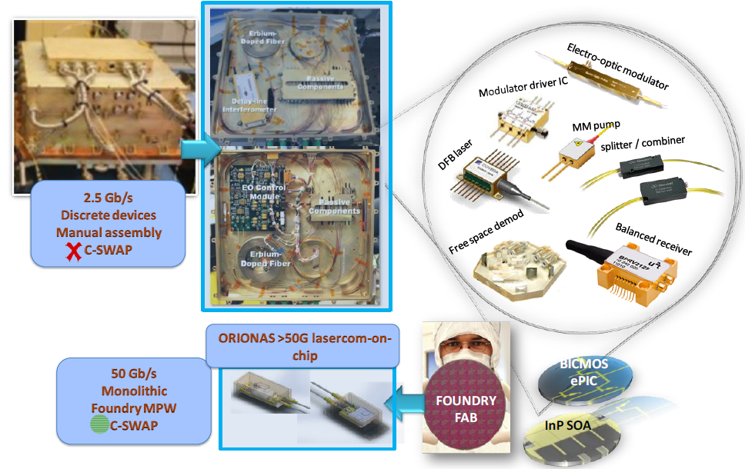
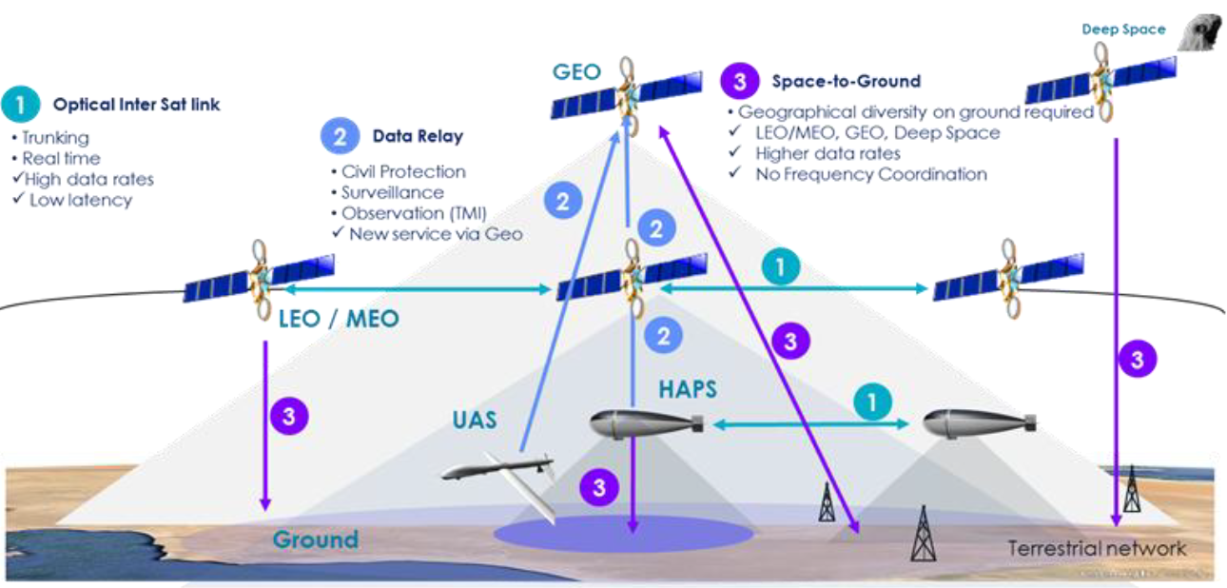
inter-satellite lasercom-links applications & OBJECTIVES
High performance BICMOS Front-End-of-Line integration platform for space ePICs
Miniaturized modulators and receivers integrated on BICMOS ePIC platform
Hi-rel and hermetic packaging of space ePICs
High power (>1W) and efficient Semiconductor Optical Booster Amplifier
Compact and efficient fiber amplifier arrays for pre-amplified lasercom receivers.
Fabrication & evaluation of Lasercom-mini-Modem (LLMM) Breadboard Model (BBM)
Notes:
Combine high performance BICMOS technology with high speed photonic devices to realize electronic-photonic integrated circuits (ePICs) and to address all scientific and technological challenges to provide a complete technology platform for the development of cost-effective and high performance space photonic
ORIONAS will develop the silicon platform on which electronic and photonic elements will be monolithically co-integrated in a BICMOS process to realize the first "space ePICs". The photonic components required by lasercom transceivers (waveguides, modulators, detectors) are realized in the front-end-of-line (FEOL), combining electronic and photonic functionality on the same substrate.
ORIONAS will use its integration platform to fabricate the Mach-Zehnder Modulator/Driver ePIC components as fully monolithic integrated circuits in a FEOL BICMOS process
ORIONAS will set the basis for the establishment of a European Hi-rel space photonics packaging platform. The ORIONAS platform will attempt for the first time epoxy-free and "all-laser weldable" module constructions setting a new reliability standard in space photonics module packaging.
ORIONAS will develop high power SOAs (HP-SOAs) with a targeted output power of 31dBm in the optical fibre . The SOAs will be used to boost the TePIC transmitter optical power in order to compensate the losses of the free space inter-satellite link
Figure : Project concept: ORIONAS aims to disrupt the way lasercom modems are designed, built and qualified in order to enable low C-SWAP satellite constellation ISLs. ORIONAS will squeeze current bulk lasercom modems into InP and Si BICMOS ePICs using cost-effective fabrication in European foundries and will fit them into small satellite constellation platforms

Slide 8
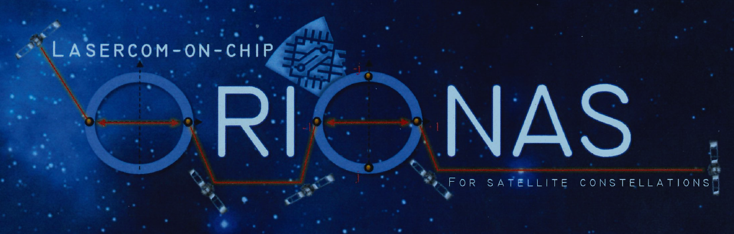
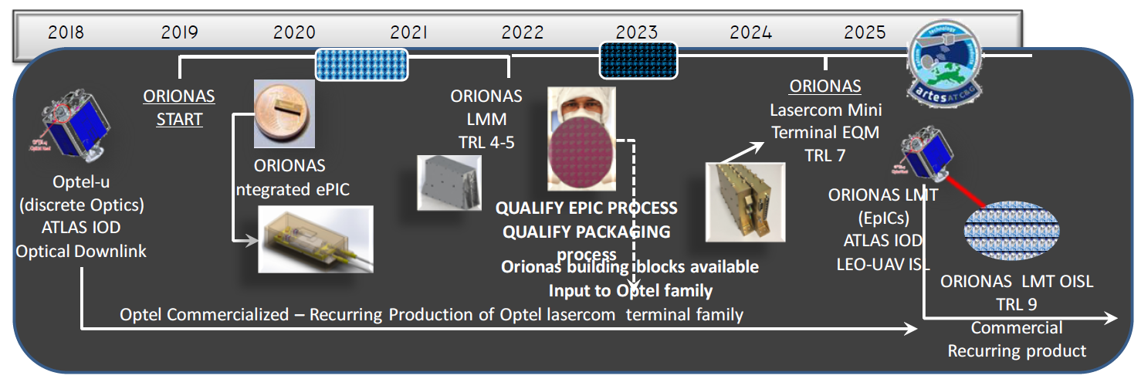
references
ORIONAS
  Is a 3-year EC-founded research project focused on the development of Photonic Integrated Circuits for next generation, high speed inter-satellite laser communications
  ORIONAS laser-mini-modem will comprise:
    Twin carrier 40 Gb/s DPKS transmitter & receiver modules
    Single carrier 40 Gb/s DQPSK transceiver module
    1 Watt Semiconductor Optical Amplifier module
    Rad-hard Erbium doped pre-amplifier module

Slide 9

Thank you
for your attention
Contact: Demetrio López
Demetrio.lopez@altertechnology.com

